Slide 1
Stroke Summary Finale
File created on: 12/18/22 4:17:16 PM EST

Slide 2
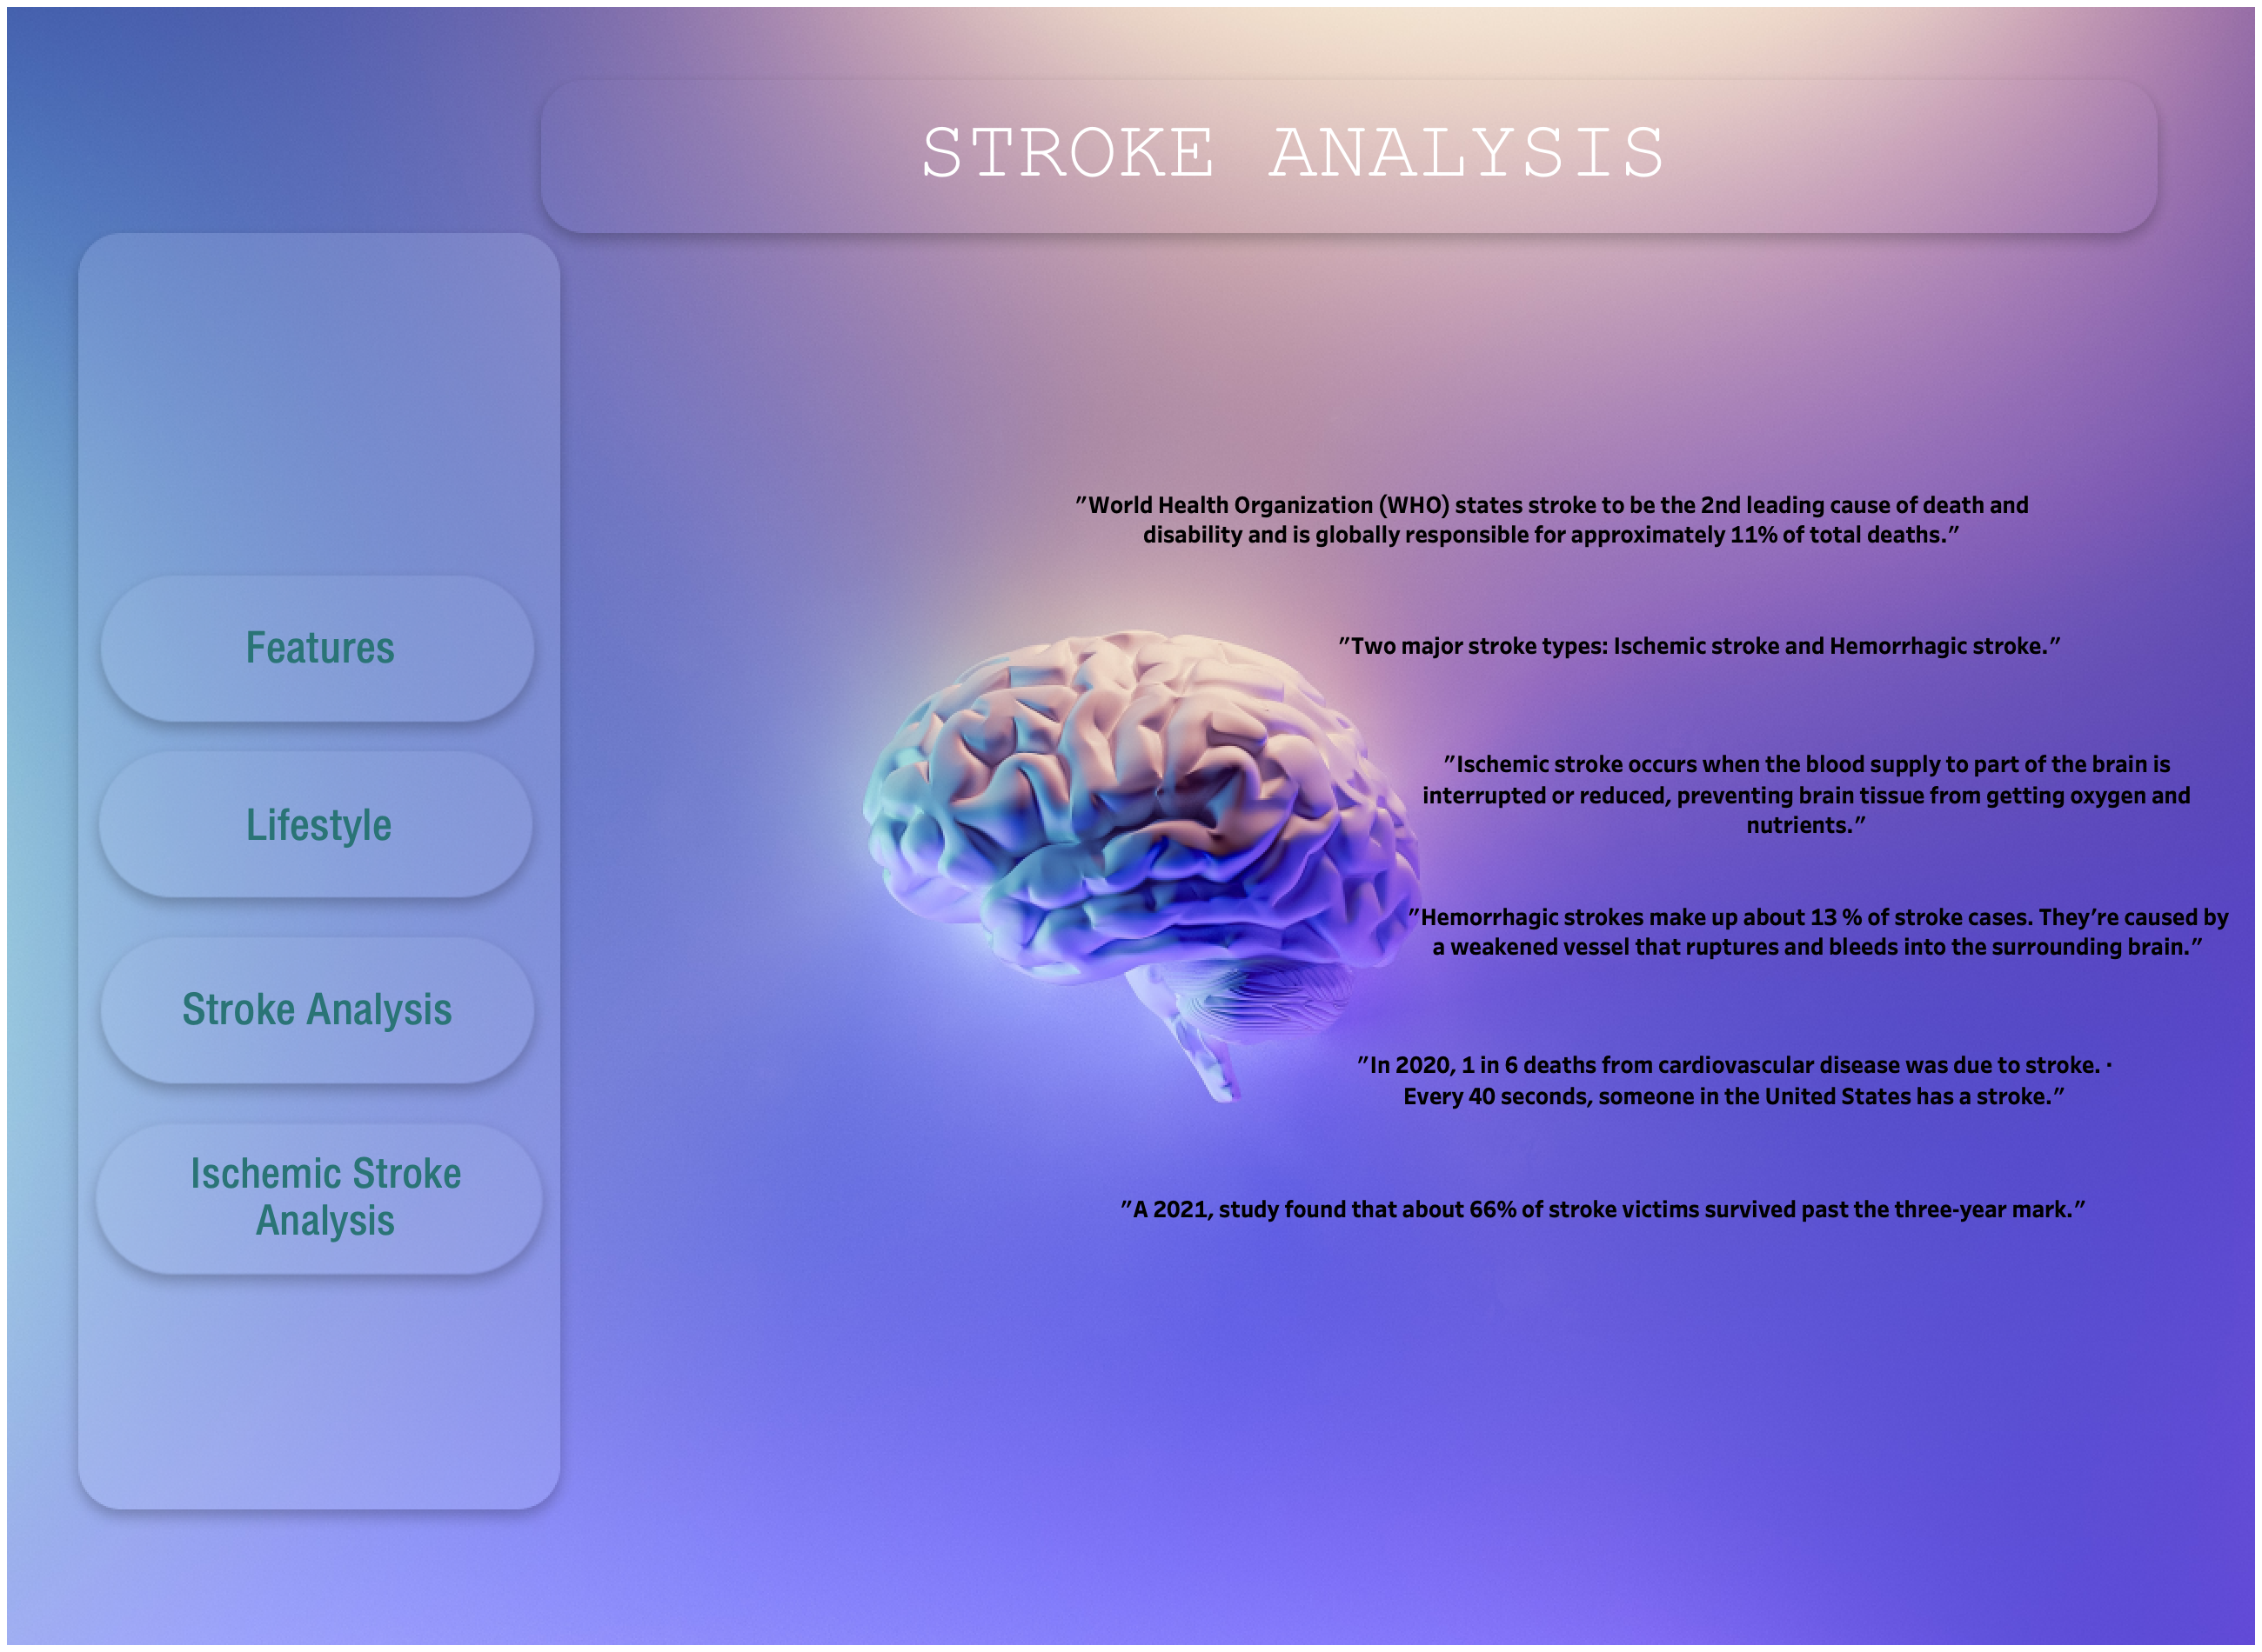

Slide 3
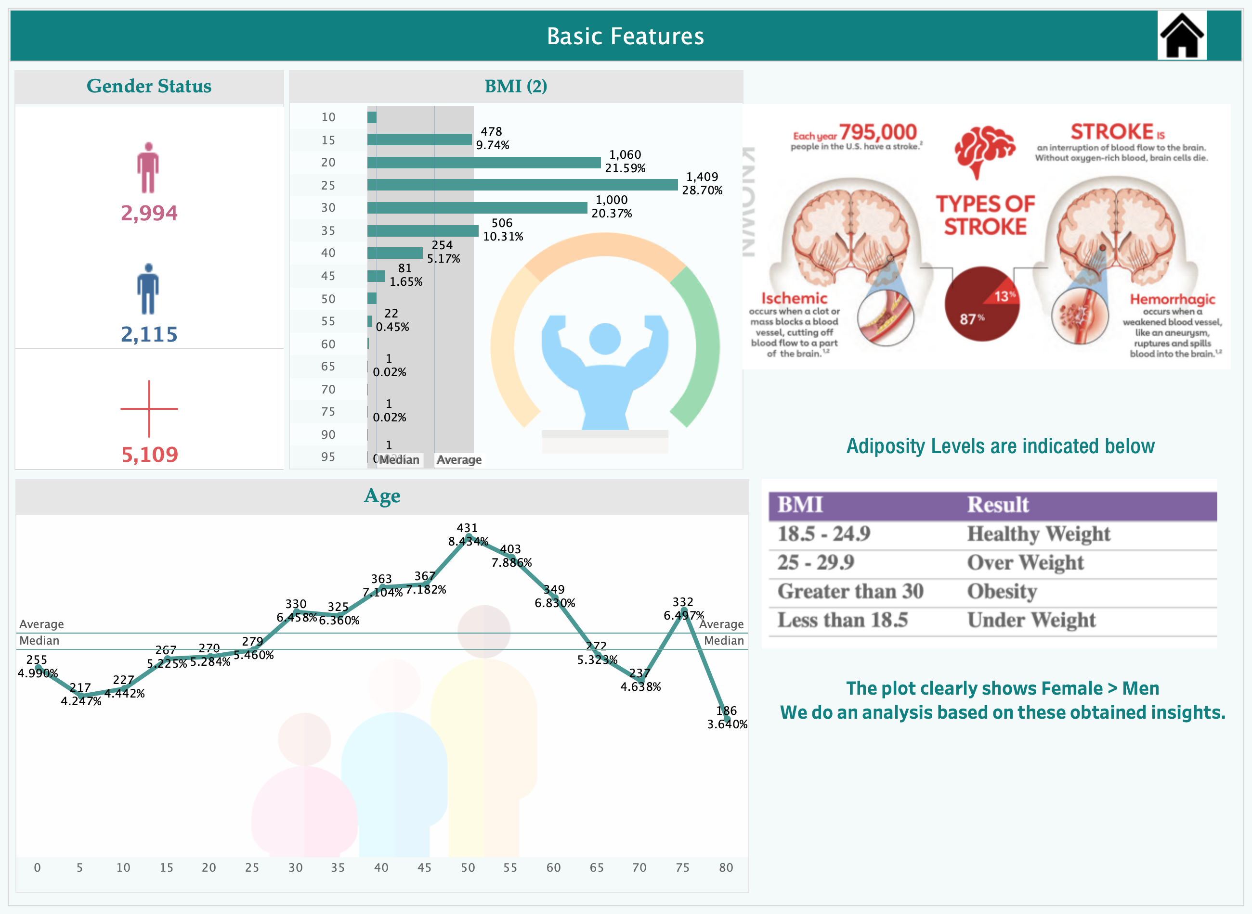

Slide 4
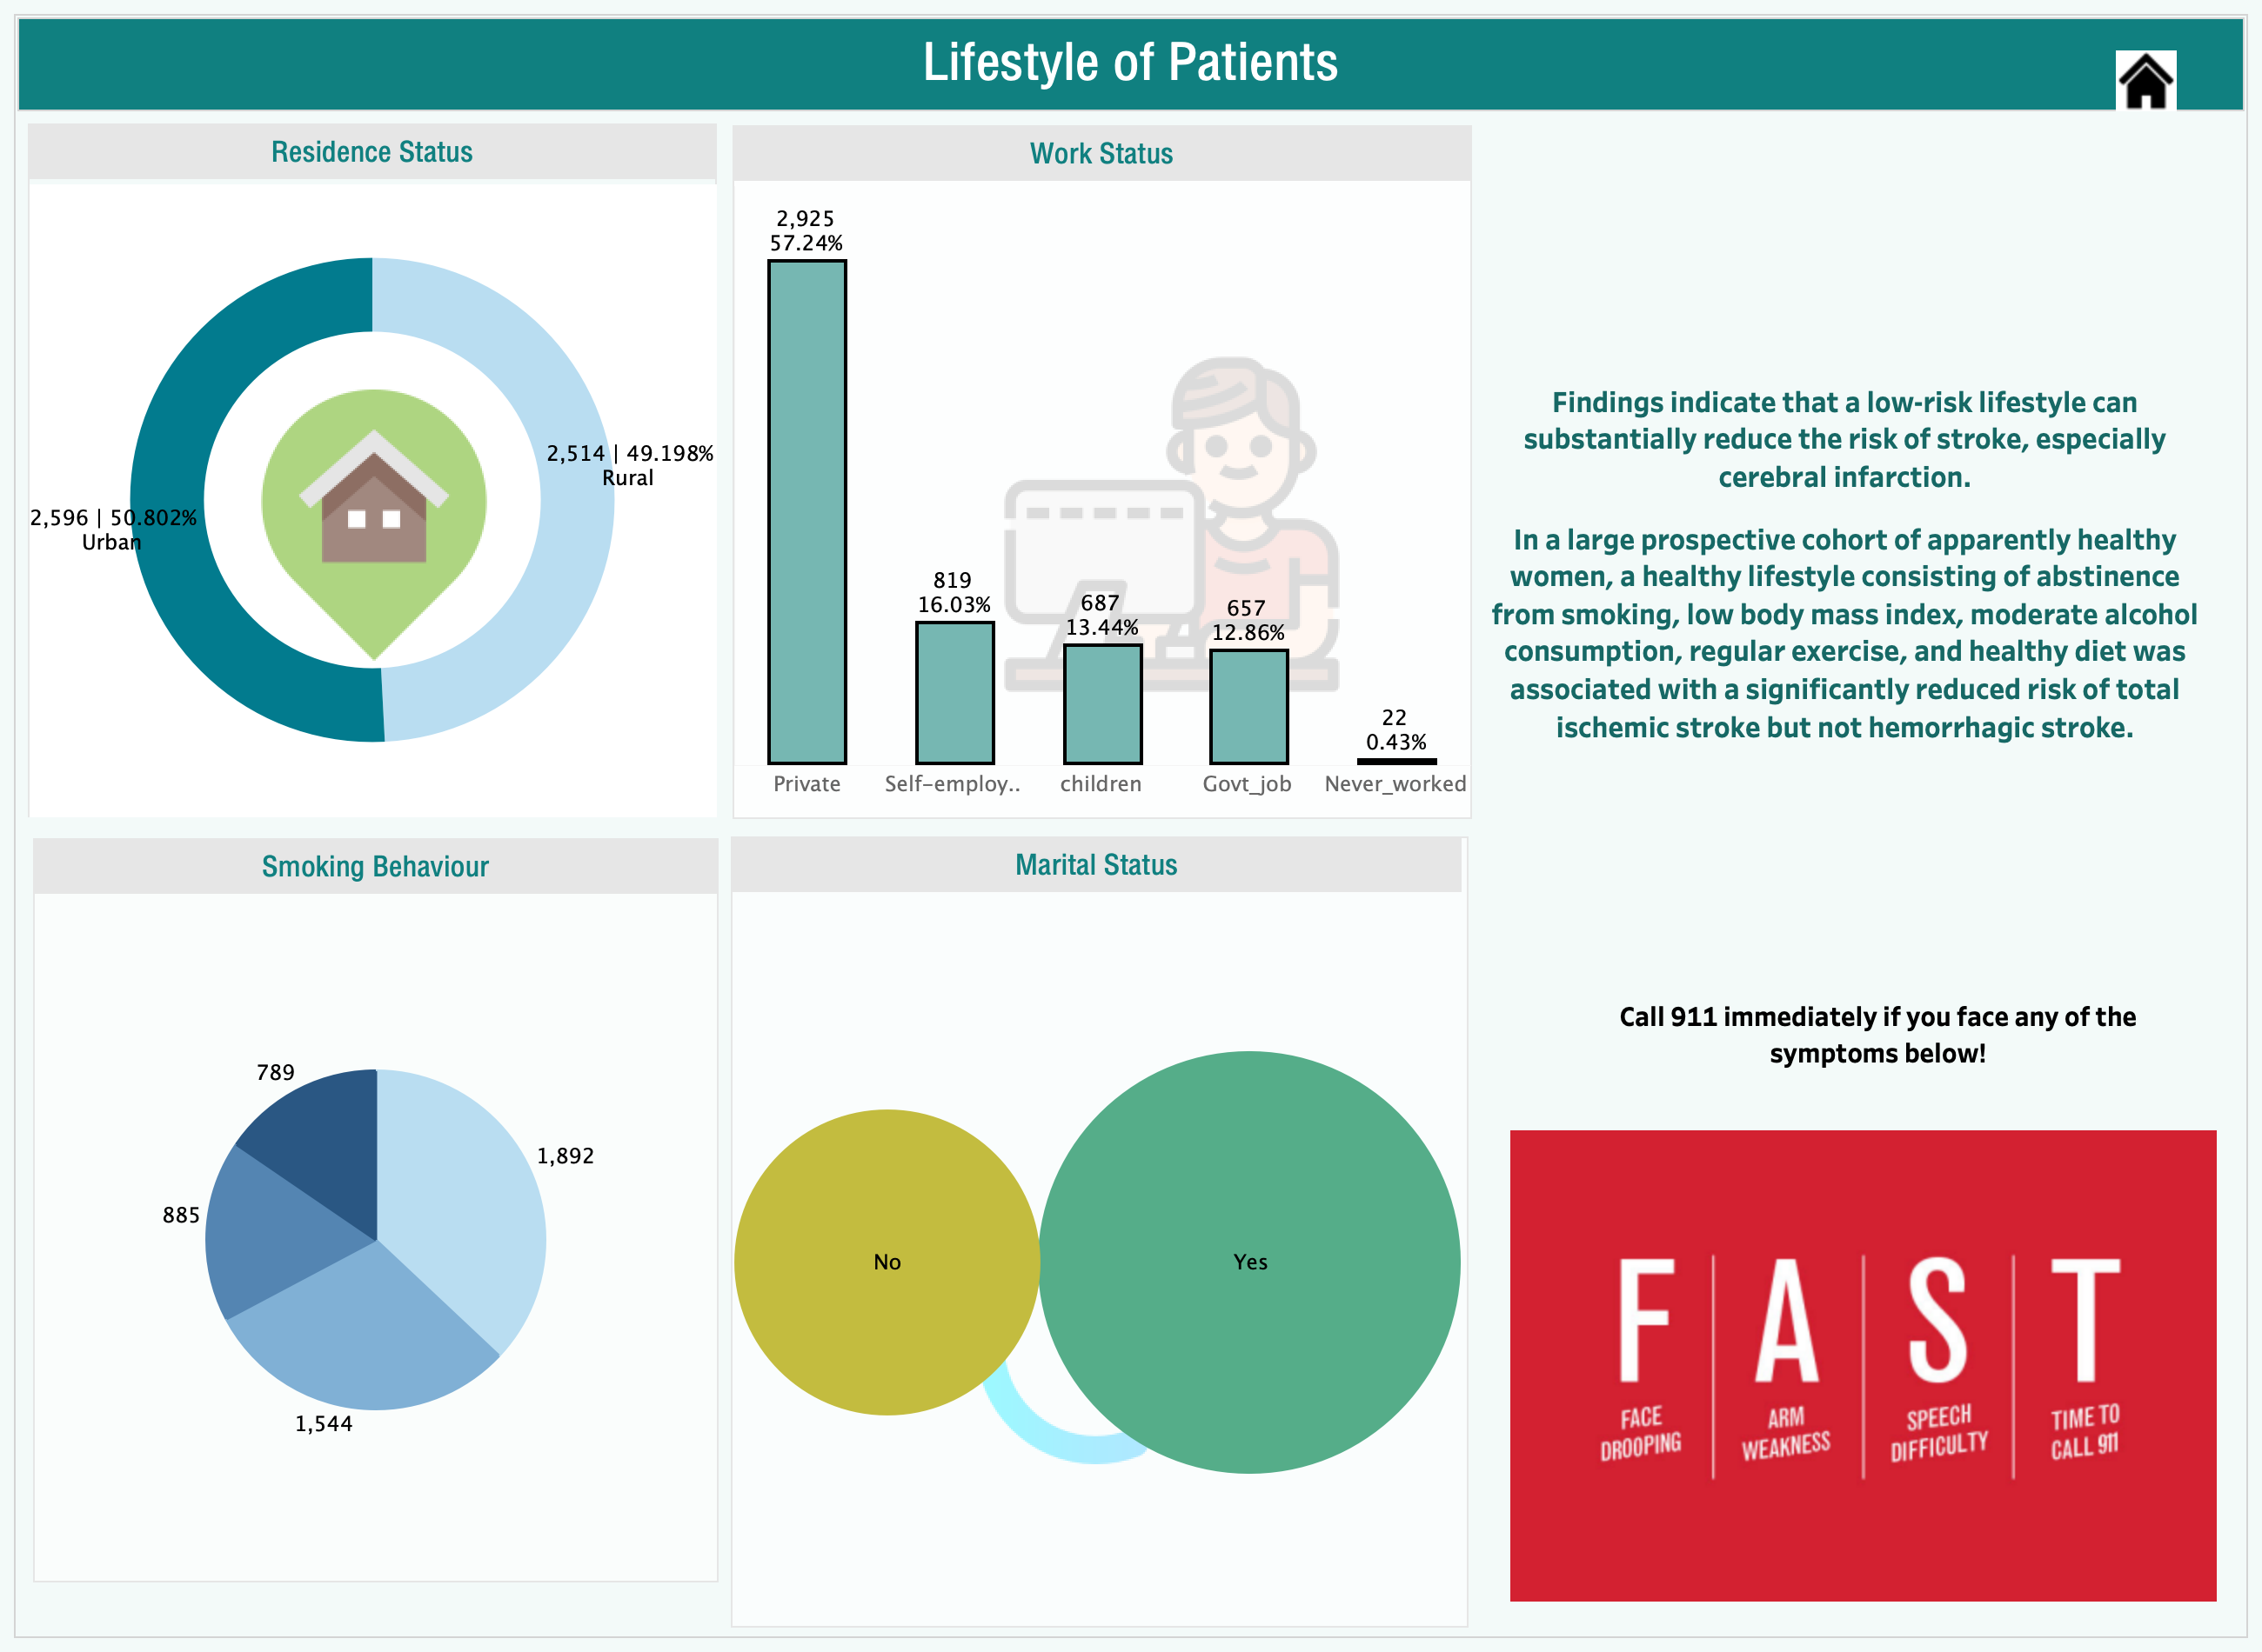

Slide 5
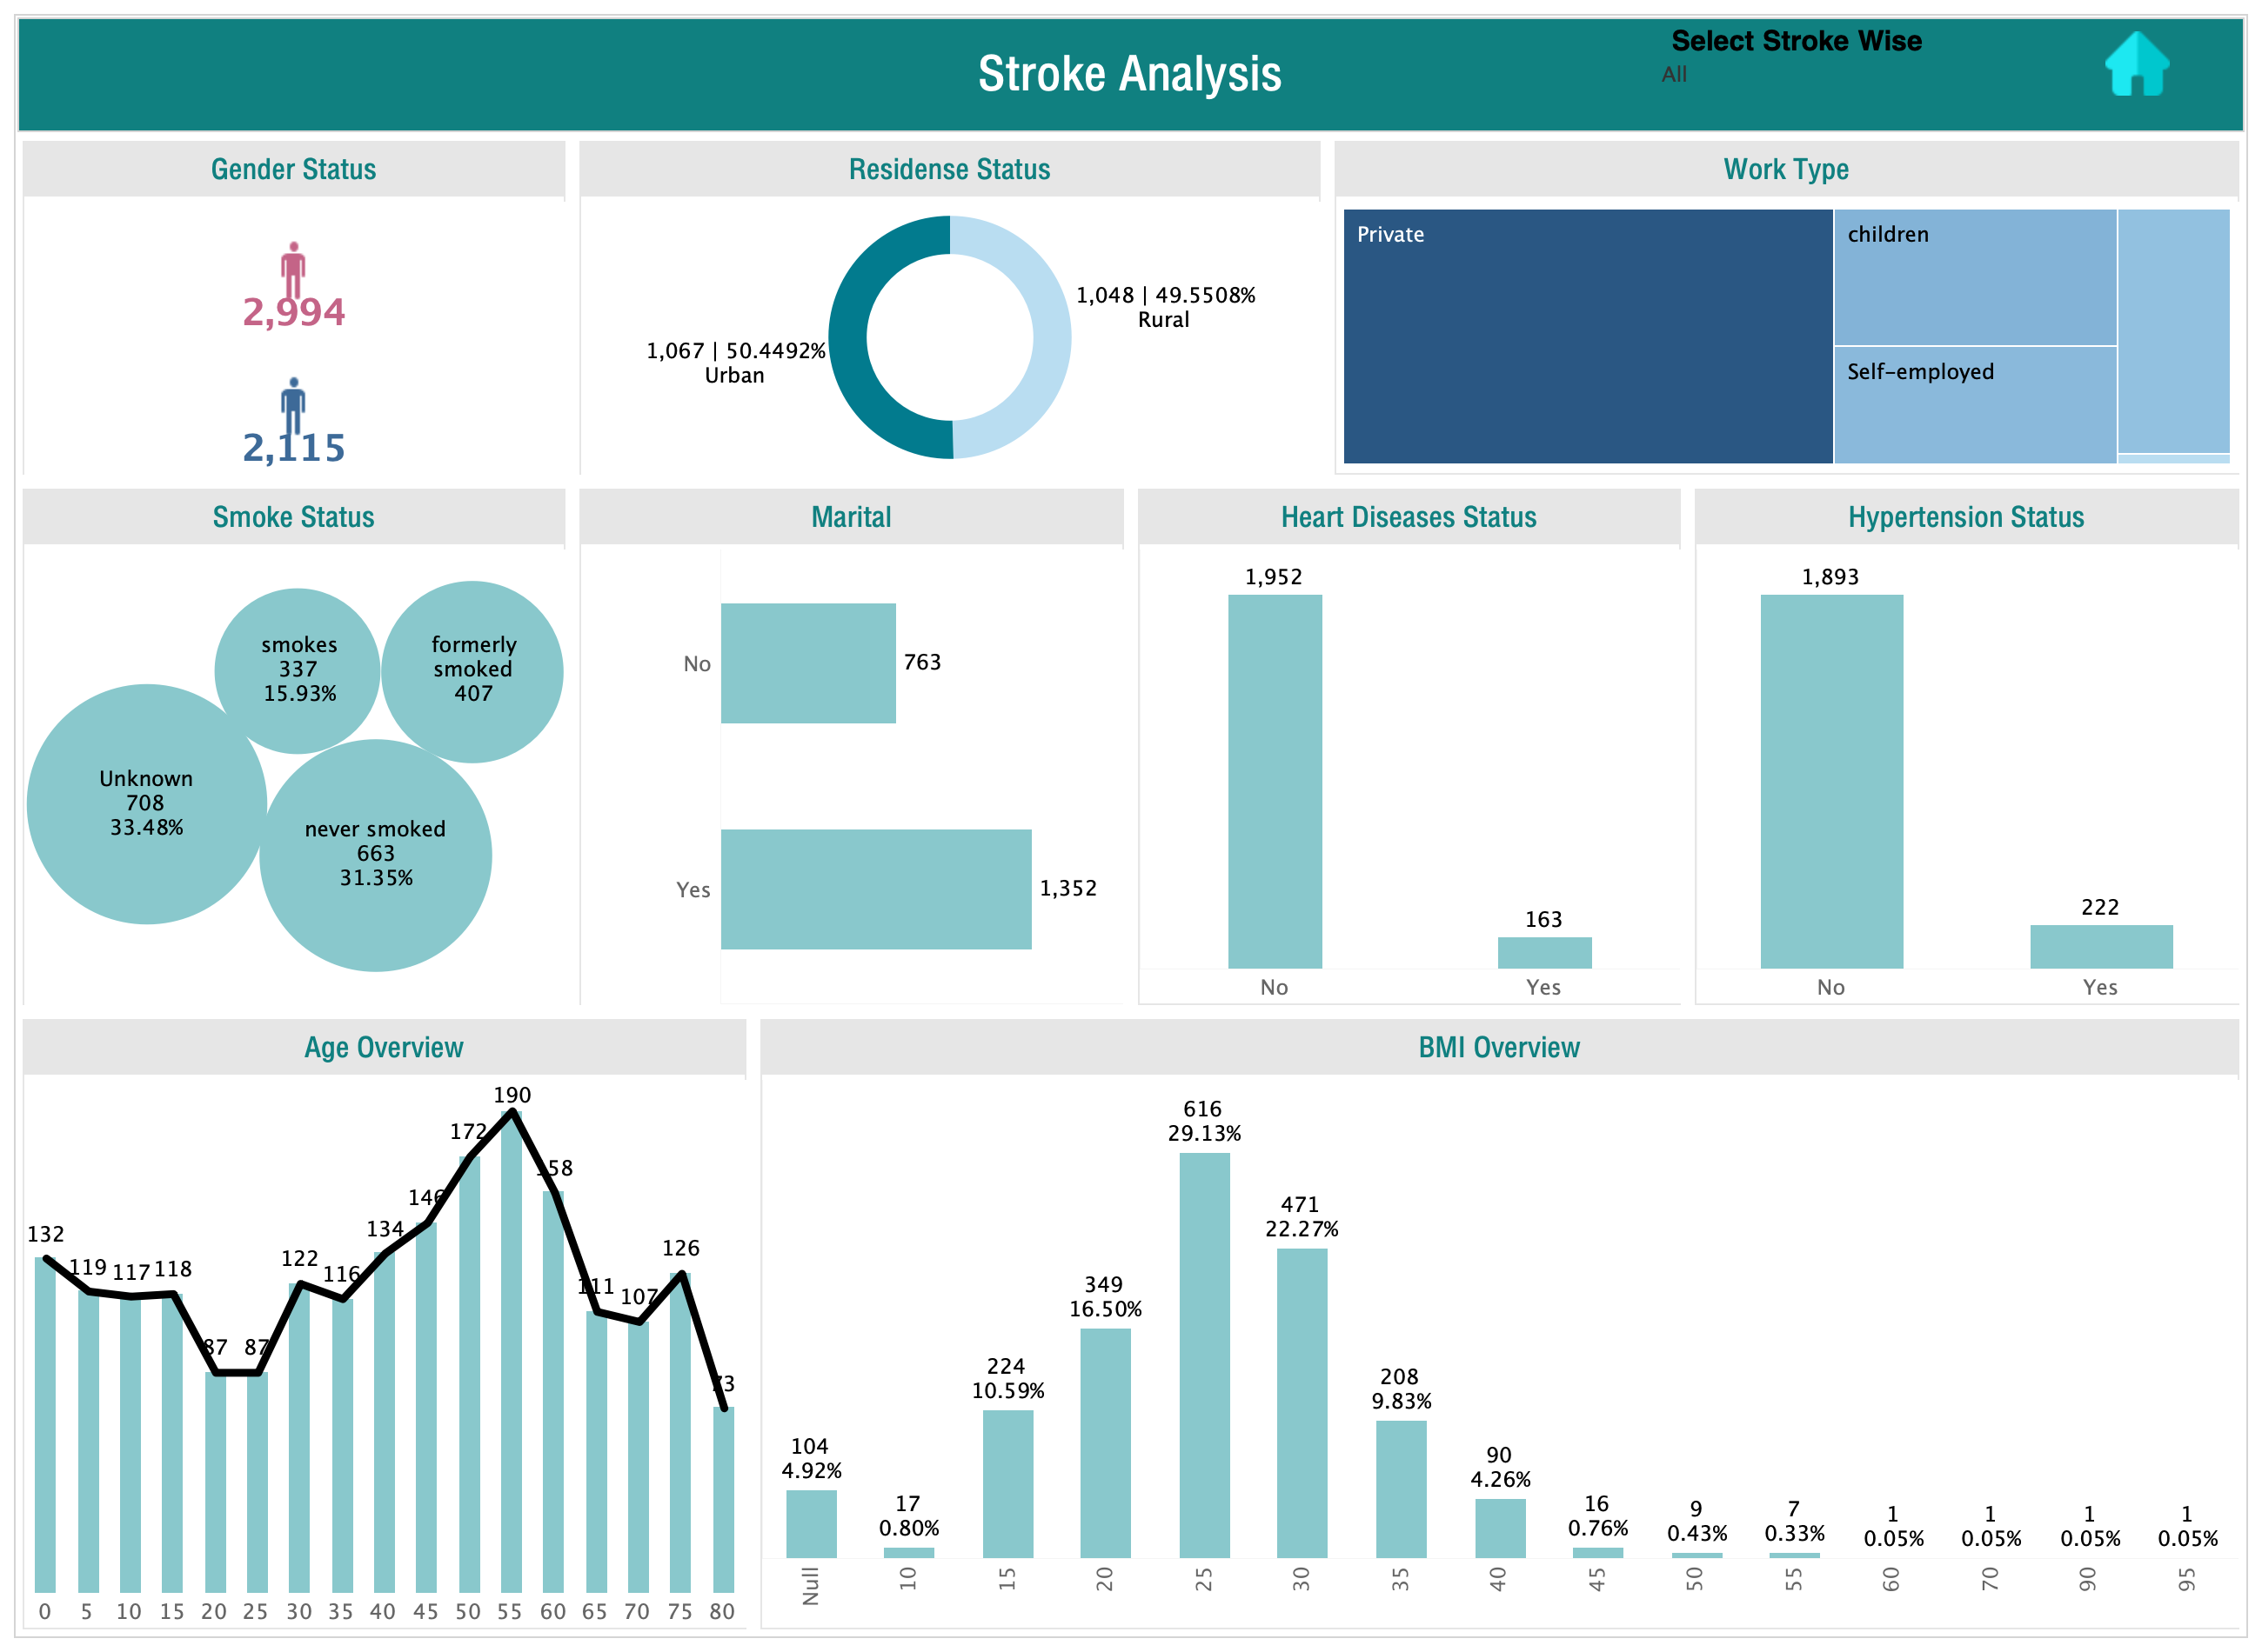

Slide 6
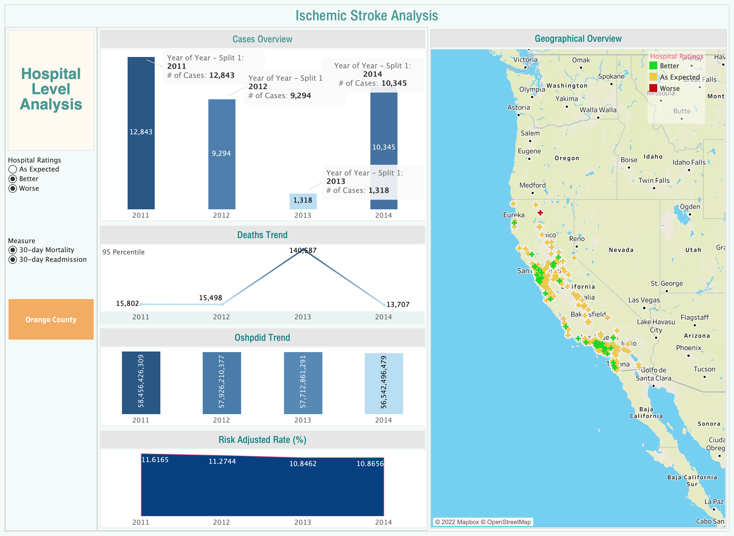

Slide 7
